Slide 1
Empowering Global AMR Research Community: Interactive GIS Dashboards for AMR Data Analysis and Informed Decision-Making Team ID: 8952

Slide 2





Meet the Team
Stephen Obol Opiyo, PhD
Data/Bioinformatics Scientist
Patira Data Science, USA
Dr. Stella Maris Nanyonga
Research Pharmacist
Oxford University, UK
Dr. Nathan Mugenyi
Global Health Researcher
Mbarara University, Uganda
Dr. Racheal Kasozi
Medical Doctor/Research Associate
Mengo Hospital, Uganda
Dr. Andrew Marvin Kanyike Medical Officer/Research Associate
Mengo Hospital, Uganda

Slide 3
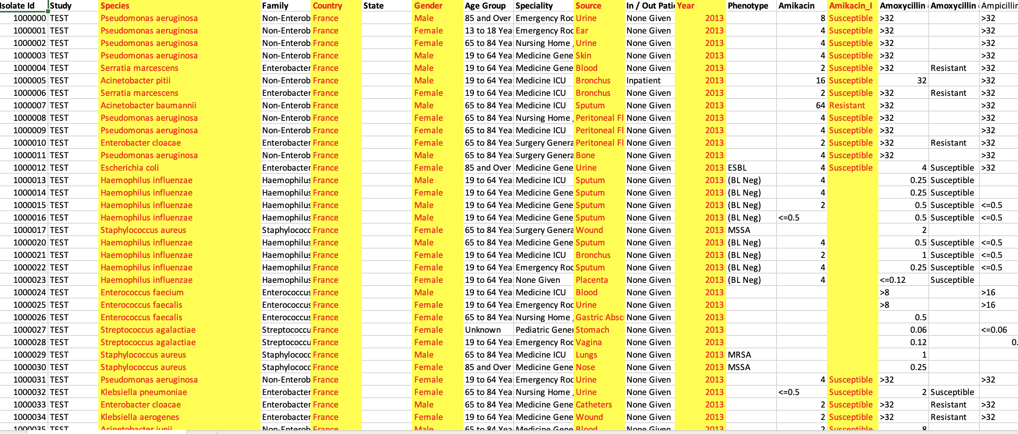
Challenges
1. No dataset from Uganda in the Vivli database in early June 2023.
2. Challenge of going through the spreadsheet of Vivli dataset: 18 years (2004 to 2021), 83 countries, 345 species, and 863,509 isolates. (spreadsheet > 860,000 rows and 126 columns).
Species
Country
Gender
Source
Year
Antimicrobial drugs
3. Kenya had three years (2013, 2014, 2021), and Uganda (2021) on June 15, 2023.
4. The African region had the lowest number of countries (13) and the fewest years of available data.

Slide 4
Opportunities/solutions
An interactive Geographical Information System (GIS) dashboard with all countries within the Vivli dataset provided.
An interactive GIS dashboard specific to the datasets from Kenya and Uganda.
An interactive GID dashboard of simulated dataset specifically for Kampala, Uganda showing zones
https://patira.maps.arcgis.com/apps/dashboards/d89c5b039552464f8f04103f05ac889f
https://patira.maps.arcgis.com/apps/dashboards/a1324c58e49e4561ac9505936db7743a
https://patira.maps.arcgis.com/apps/dashboards/095acc30606c4c7a8bc8260e6160c511

Slide 5
Impact of the work
GIS dashboard can be used by healthcare professionals:
Provides real time information to guide in decisions making, e.g. use of antibiotics.
Easy detection of outbreaks by showing clusters of cases in a specific region or health facility.
GIS dashboard can be used by policymakers:
Effective surveillance for different areas including those with limited access to health services.
Shows the geographic distribution of resistant pathogens and trends.
GIS dashboard can be used by researchers:
Enables data sharing which fosters communication and collaboration.
Integrate data from different sources enabling a comprehensive view of the data for analysis and interpretation.

Slide 6
Acknowledgments
The Vivli AMR Team
Welcome
Presentation is based on research using data from Pfizer, obtained through https://amr.vivli.org"
The judging panel
This presentation is based on research using data from (2023_06_15 atlas_antibiotics; Pfizer), obtained through https://amr.vivli.org

Slide 7
Thank you
Questions????

